Slide 1
ML 3021
Final Presentation
UVA BSDS
Ivey Mistele, Zoe Hendershot, Carrie Feng

Slide 2
Question & Background:
Q: How well can biological characteristics and lifestyle factors predict an individual’s weight category?
Method: Classification Decision Tree
Target variable: NObeyesdad (4 levels: Insufficient weight, normal weight, overweight, obese)
Independent variables:
Gender, Age, Height, Weight, family_history_with_overweight, FAVC, FCVC, NCP, CAEC, SMOKE, CH2O, SCC, FAF, TUE, CALC, MTRANS
Background:
The CDC identifies physical activity, eating patterns, sleep quality and quantity, and electronic use as key risk factors for obesity. Our dataset, from the class data folder, includes many of these lifestyle-related risk factors as features.
Notes:
Project Goal:
Use a Decision Tree Classifier to predict obesity levels based on lifestyle habits and biological traits.
Explore how well these lifestyle features and traits can explain obesity status.
Further Exploration:
Analyze which specific risk factors have the largest impact on obesity level based on feature importance.
Public Health Application:
Findings could guide public health initiatives by prioritizing prevention efforts on the most influential risk factors.

Slide 3
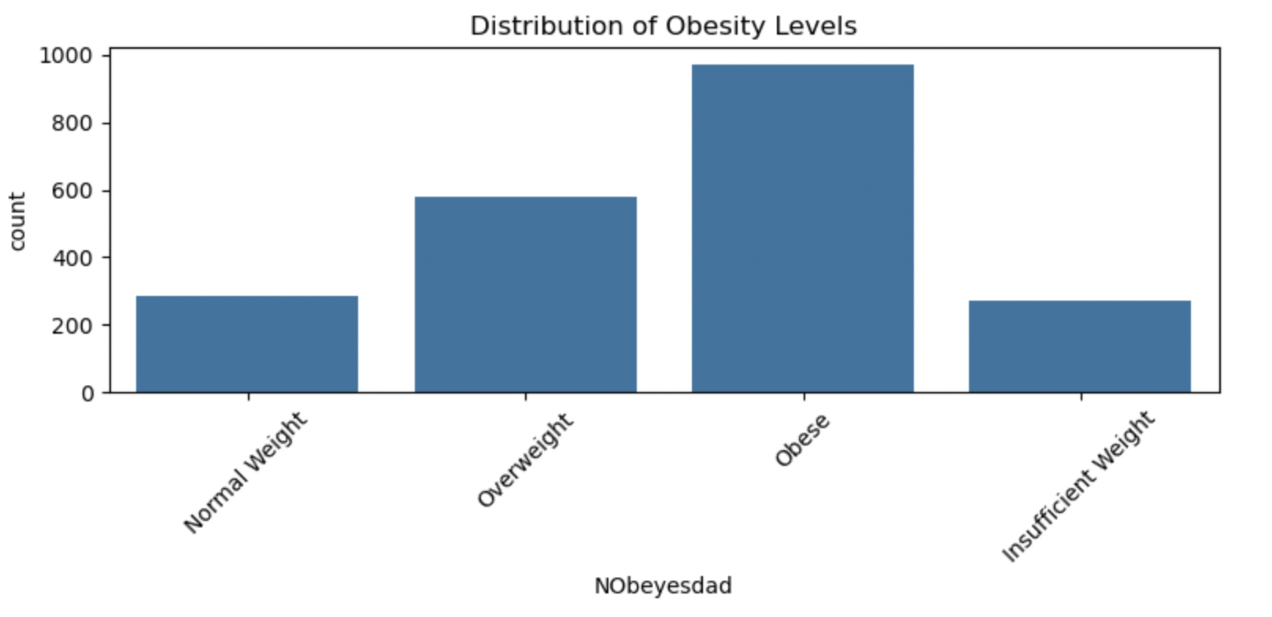
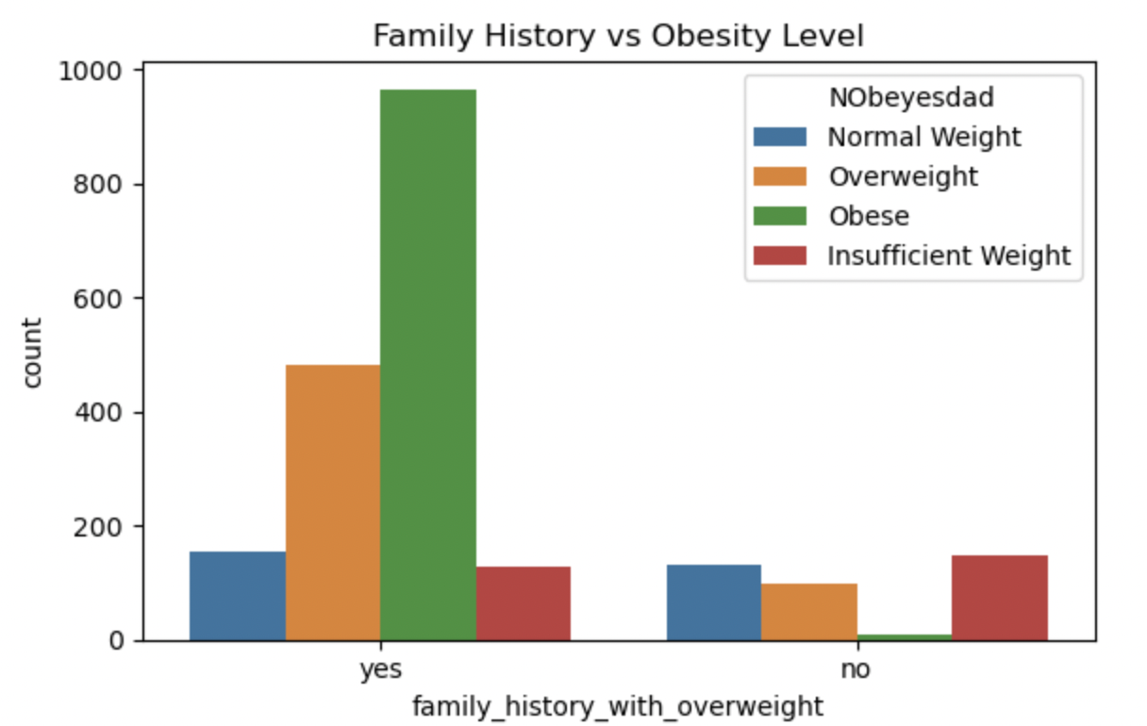
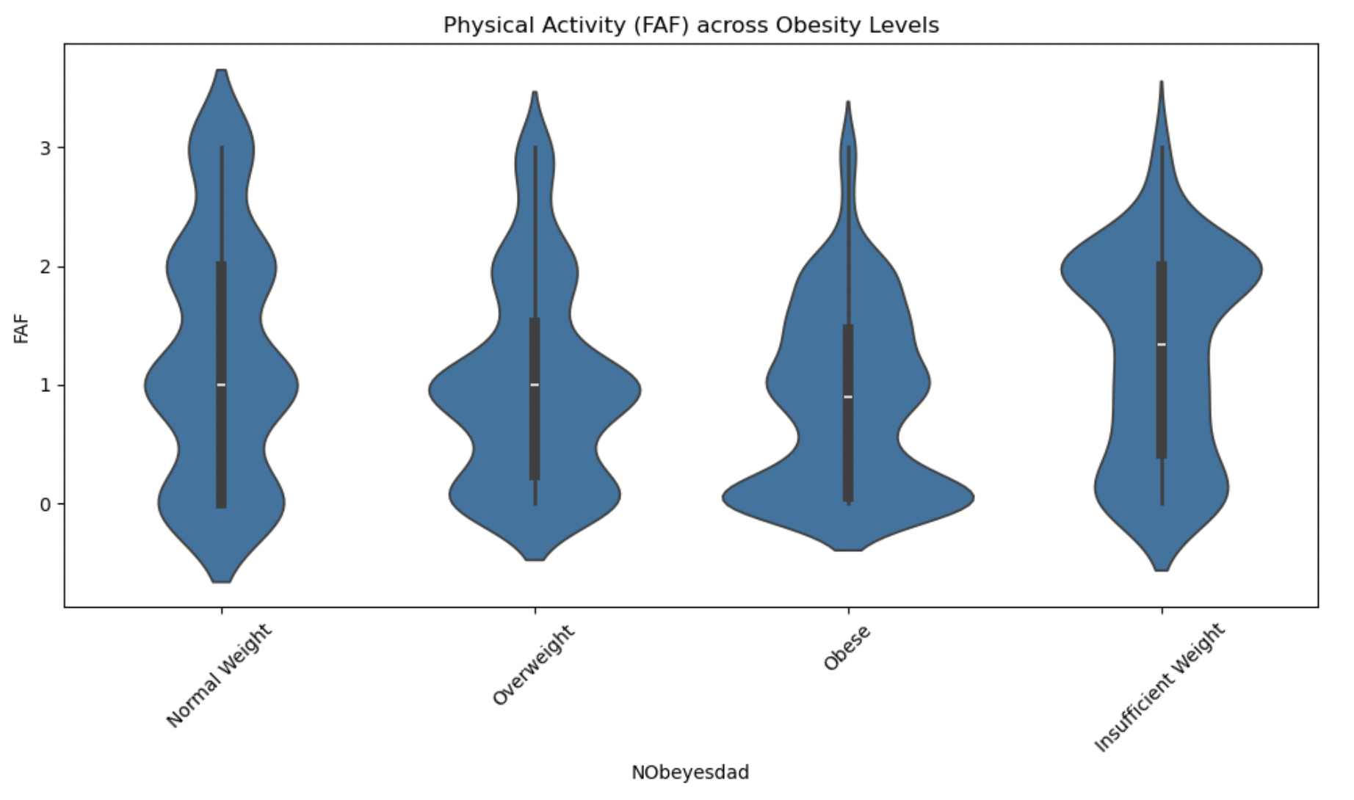
EDA
Notes:
Our EDA showed that variables such as physical activity (FAF), frequency of vegetable consumption (FCVC), and daily water intake (CH2O) appeared important predictors of obesity.
Prevalence: most of our samples were obese, how common each class is; how much of each positive; proportion of the variable we are trying to predict
2 of the features that shows distribution of how they impact obesity level and weight

Slide 4
Method: Preparing + Building the Model
Preparing the Data
Collapsed the original 7 obesity categories into 4 broader groups for classification: Insufficient Weight, Normal Weight, Overweight, and Obese
Dropped direct physical variables, like Height and Weight, which overpredict
Label Encoding to transform all categorical features into numeric format
Building the Model
Split the dataset into train, tune, test
Decision Tree Classifier to model non-linear relationships between features and obesity outcomes
Tuned several hyperparameters and selected the hyperparameter max_depth
Selected the final model based on the highest F1-macro score to evaluate performance across all obesity categories
Notes:
precision_macro → checks false positives for each class.
f1_macro → balances false positives and false negatives.
balanced_accuracy → adjusts for any imbalance between classes.

Slide 5
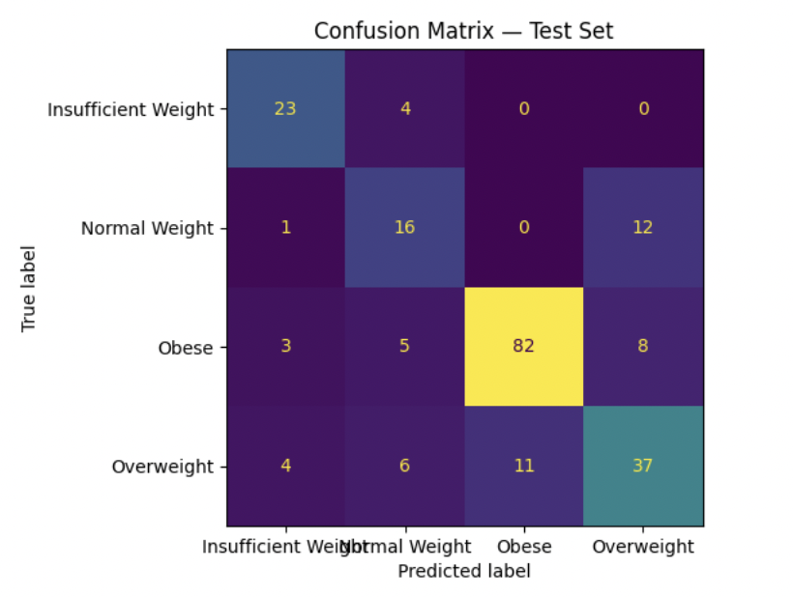
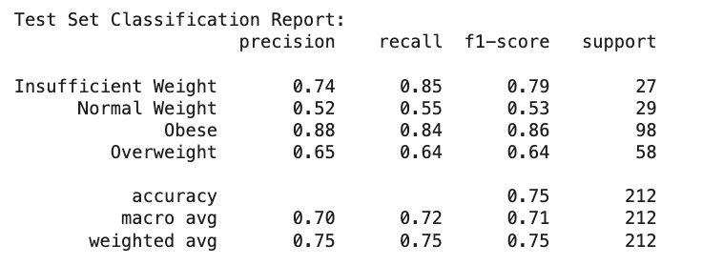
Evaluation of our model
Scoring Metrics
Used precision, recall, F1-macro score, and balanced accuracy to assess all classes.
precision_macro: checks FP for each class
Recall: identifies how many true positives were identified correctly
f1_macro: balance FP and FN
balanced_accuracy: adjusts for any imbalance between classes
Focused on F1-macro as the main metric because it balances precision and recall across multiple obesity classes.
Model Results
Slight skew towards false positives for obesity/overweight
Notes:
precision_macro → checks false positives for each class.
f1_macro → balances false positives and false negatives.
balanced_accuracy → adjusts for any imbalance between classes.
High recall = fewer false negatives.
It’s useful when missing a positive case is more dangerous than making a false positive.
Confusion Matrix:
Visualized the confusion matrix to identify which obesity categories were most commonly confused.
model performed best distinguishing Normal Weight and Obese, but struggled more between Overweight and Obese.
Data Frame of Evaluation Metrics

Slide 6
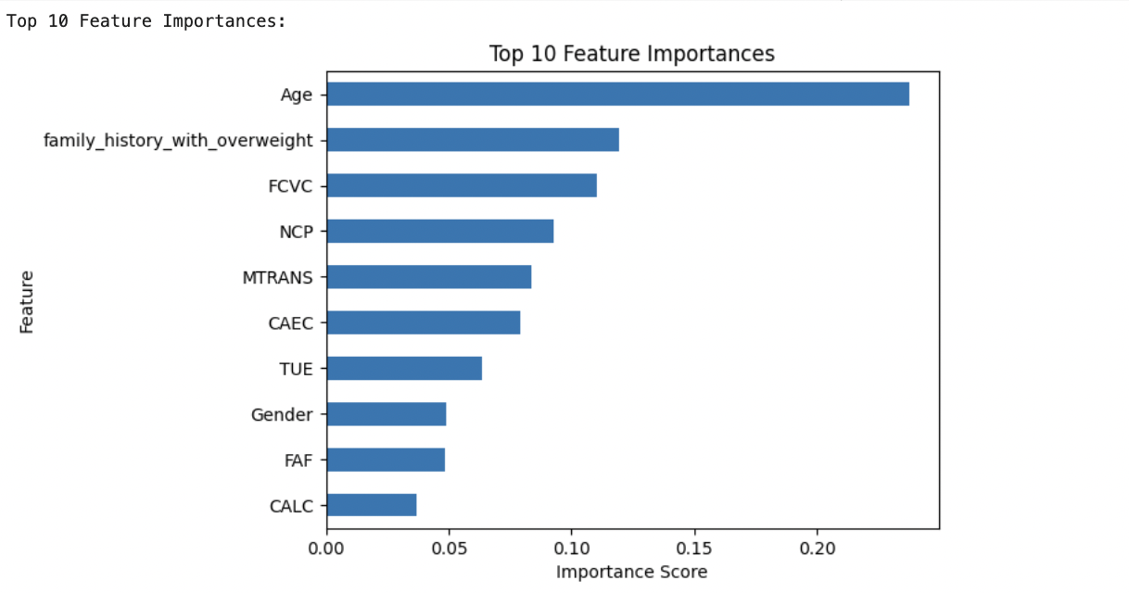
Feature Importances
Age
Family history with overweight
FCVC: Frequency of vegetable consumption
NCP: Number of meals per day
MTRANS: Main mode of transportation
CAEC: Consumption of food between meals
TUE: Time spent using electronic devices
Gender
FAF: Frequency of physical activity
CALC: Alcohol consumption
Notes:
feature importances show how lifestyle choices are relevant. interesting that physical activity is less relevant than water consumption and electronic time

Slide 7
Limitations and Future Work
Improving the model
Implement ensemble methods with Random Forest, reducing overfitting
Feature engineering
Incorporate more meaningful data
Limitations of our model
Self reported data
Multicollinearity
Unclear data origin
Applications
Feature importances can inform public health policymakers on where to focus their efforts.
Notes:
ensemble methods - using multiple models
feature engineering - : explore how variables impact each other, create new features, explore relationships
more data: potentially exploring the biological side more (genetic data), or incorporating class data (wealth status) as this was not in our original dataset
One limitation of the obesity dataset is the potential for multicollinearity among predictors. For example, calorie consumption and fat intake may be highly correlated, leading to redundancy in the feature space. This could inflate the apparent importance of related features and make it harder to interpret which behaviors are most predictive of obesity.

Slide 8
Thank you!
Confidential

Slide 9
appendix

Slide 10
Method: Why Decision Tree?
Easy to interpret - helps real-world application for public health information
Handles numeric and categorical data without much data preprocessing, no need to standardize data
Cross-validation and hyperparameter tuning helps check overfitting the data
Cross-validation: train and test are disjoint, k-fold uses both sets to both train and test
Confidential

Slide 11
Hyperparameter Tuning
Results
Best model tuned on max_depth (Macro F1= 0.73)
We chose Macro f1 as our refit to treat all four obesity classes equally
Adding min_samples_leaf, min_samples_split, max_features or max_leaf_nodes didn’t boost accuracy or F1
GridSearchCV still picked the max_depth tree as optimal
Experimented with:
Minimum samples for a node split
Minimum samples for a terminal node (leaf)
Maximum depth of a tree (vertical depth)
Maximum number of terminal nodes
Maximum features to consider for split
Takeaway: more hyperparameters didn’t improve performance
hyperparameter | accuracy | precision | recall | f1
max_depth | 0.75 | 0.75 | 0.72 | 0.73
min_samples_leaf | 0.75 | 0.70 | 0.72 | 0.71
min_samples_split | 0.75 | 0.74 | 0.72 | 0.73
max_features | 0.68 | 0.64 | 0.65 | 0.64
max_leaf_nodes | 0.68 | 0.64 | 0.65 | 0.64

Slide 12
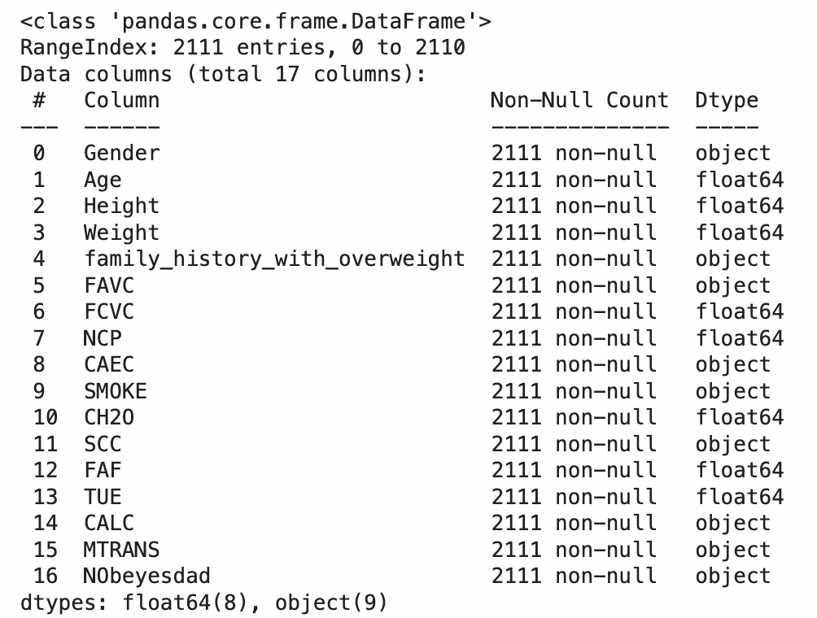
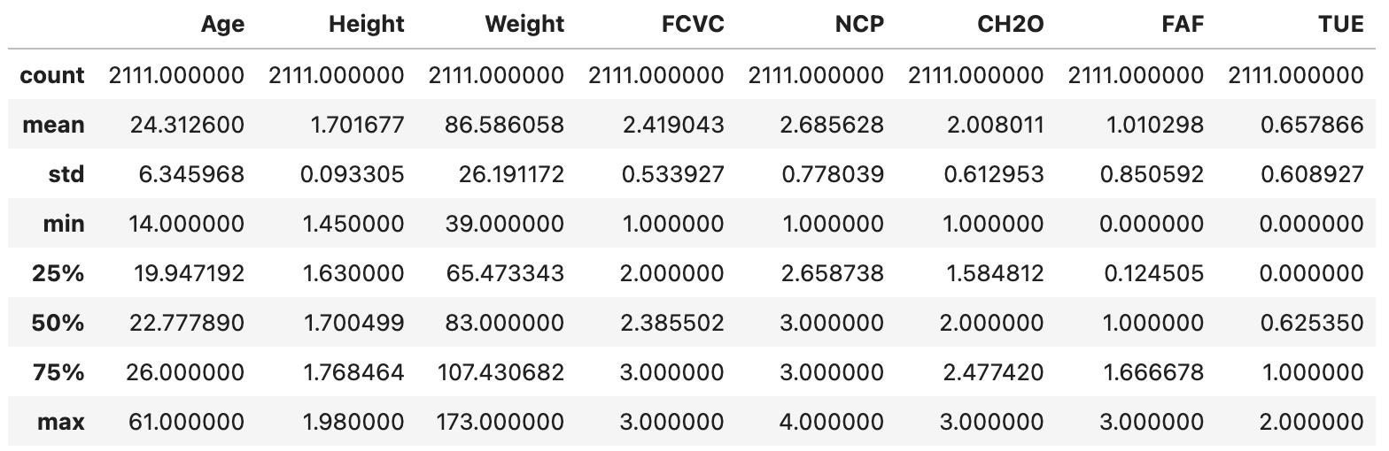

Slide 13
Math behind Method
Greedy algorithm: algorithm chooses best split by SSE at that node, doesn’t look to future - minimizes gini impurity at every split
Cross validation - using kfold to cross validate train and test
- Math behind it (Gini Coefficient, Entropy)
gini impurity: how mixed the classes are inside a node
split attempts to minimize gini impurity (chance that randomly chosen item is misclassified)
entropy: amount of uncertainty in a node (pure node=one class: entropy = 0)
Notes:
things to be able to explain:
scoring metrics and selection (determines how the model is evaluated)
hyperparameters and hyperparameter tuning
Stratified K-Fold (cross validation) for overfitting
data processing (collapsed target and label encoding)

